Slide 1

Capacitor degradation model
Aqarib Hussain

Slide 2
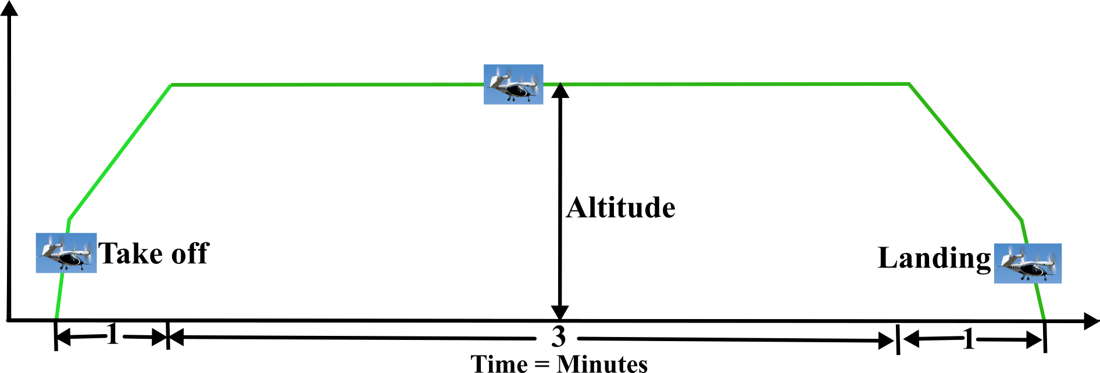
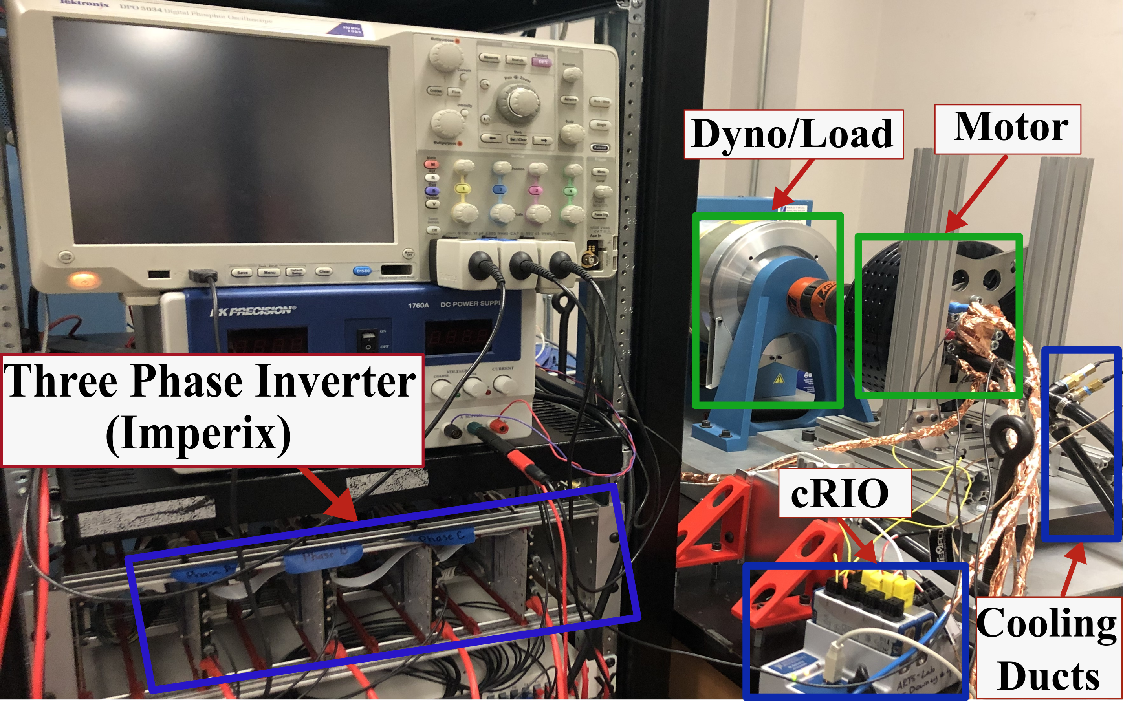
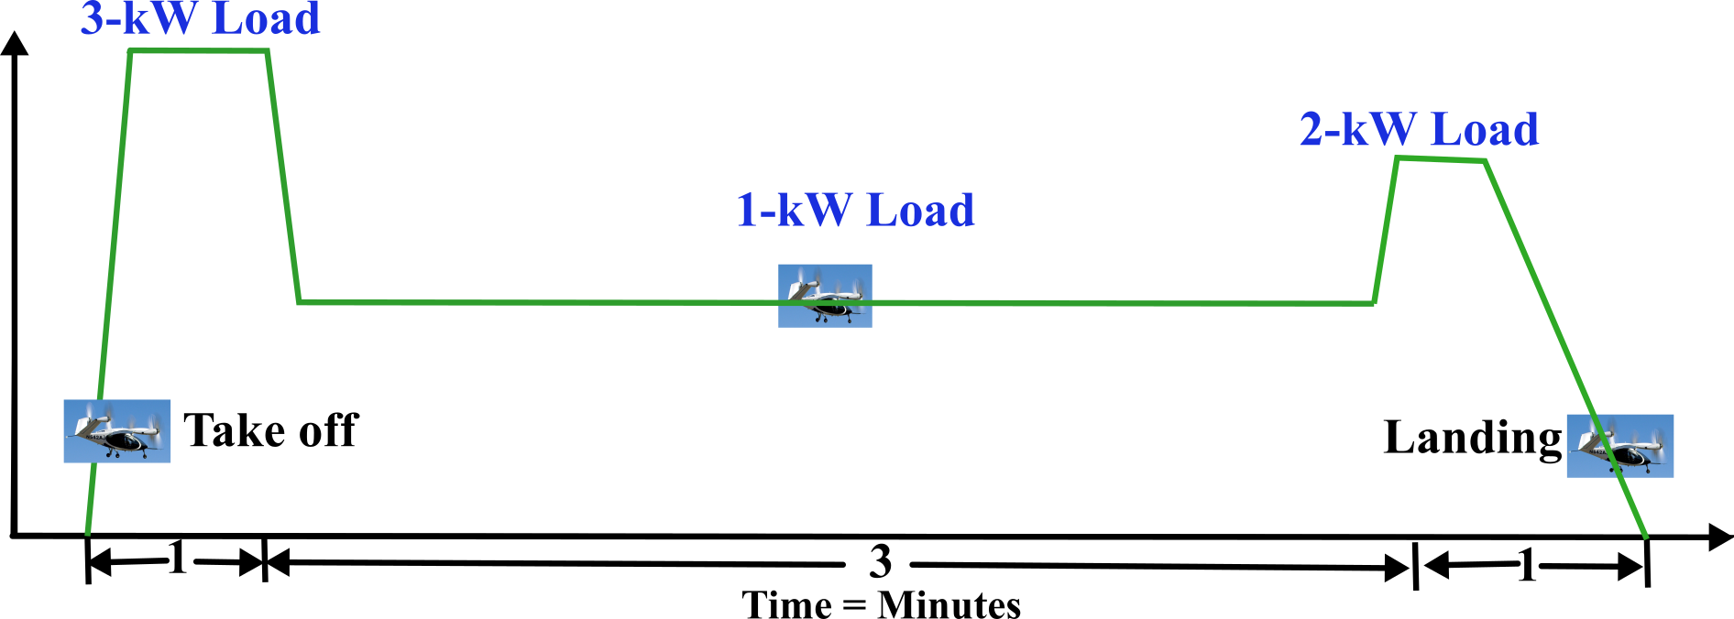
Testbed and Flight profile
Testbed setup.
eVTOL flight profile and Load profile.

Slide 3
How can Capacitor degradation affect evtol powertrain ?
Few causes of capacitor failure include exceeding the maximum ratings for the following parameters:
The ripple current
Ambient temperature
Operating Voltage
Failure distribution among major components [1].
[1] H. Wang, M. Liserre and F. Blaabjerg, "Toward Reliable Power Electronics: Challenges, Design Tools, and Opportunities," in IEEE Industrial Electronics Magazine, vol. 7, no. 2, pp. 17-26, June 2013, doi: 10.1109/MIE.2013.2252958.v

Slide 4
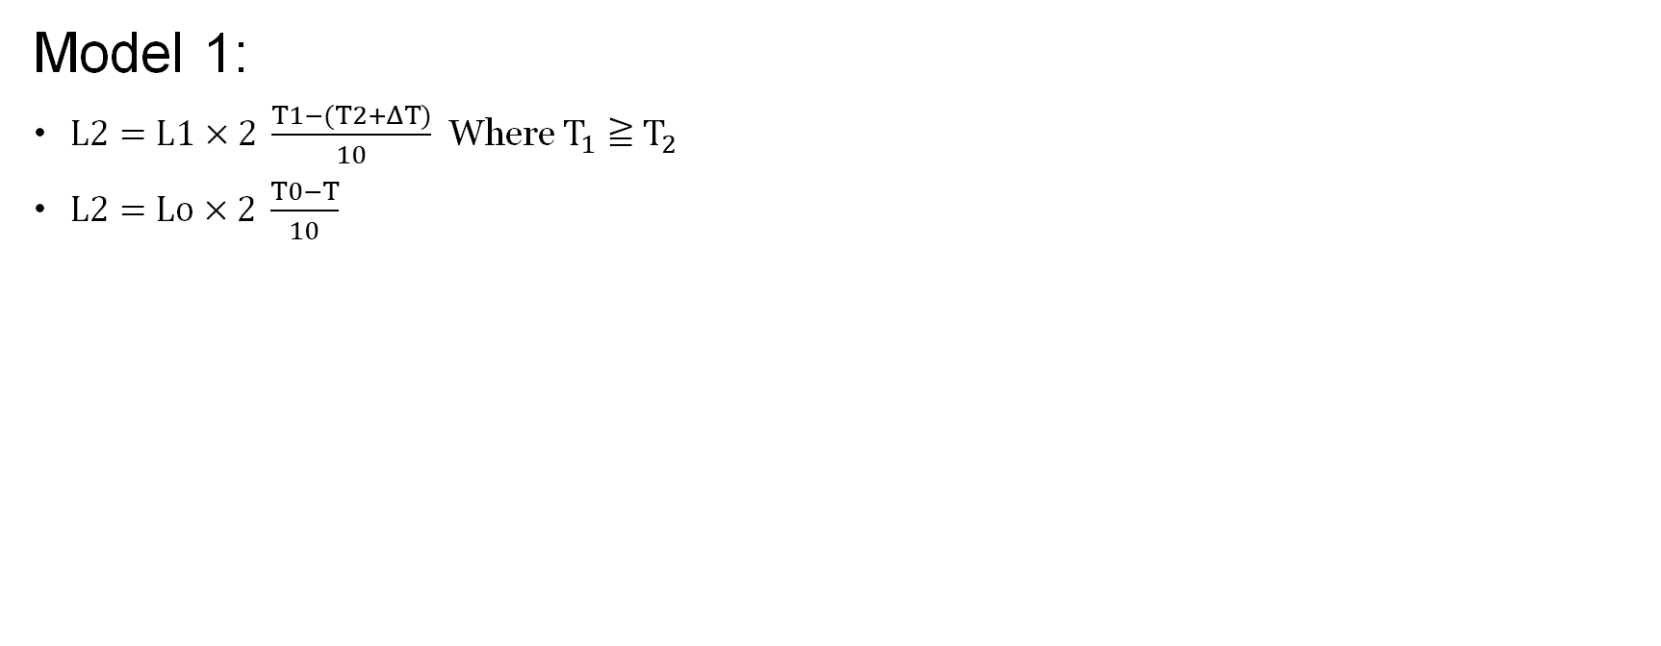
Degradation model studied
Model 1:
$L2=L1×2 \frac{T1−(T2+ΔT)}{10}$ Where $T_{1}≧{ T}_{2}$
$L2=Lo×2 \frac{T0−T}{10}$
L : Expected life in actual use [hour]
T: Actual ambient temperature + temperature rise due to ripple current [∘ C]
Lo : Guaranteed life of capacitor [hour]
To : 1) Product that defines the endurance by superimposing the rated ripple current. Upper category temperature of capacitor + temperature rise (5∘C) due to rated ripple current [∘C]
2) Product that defines the endurance by applying a rated voltage. Upper category temperature of capacitor [∘ C]
L1 : Guaranteed life (h) at temperature T1 (℃).
L2 : Expected life (h) at temperature T2 (℃) * In the case of a hybrid type, category temperature (℃).
T1 : Upper category temperature (℃) + temperature increase caused by rated ripple current (℃).
T2 : Ambient temperature of capacitor (℃).
⊿T : Temperature increase caused by ripple current (℃) .
https://industrial.panasonic.com/content/data/CP/PDF/Alumi/Alumi_TechnicalGuide_e.pdf
https://industrial.panasonic.com/cdbs/www-data/pdf/RDF0000/ABA0000C1026.pdf

Slide 5
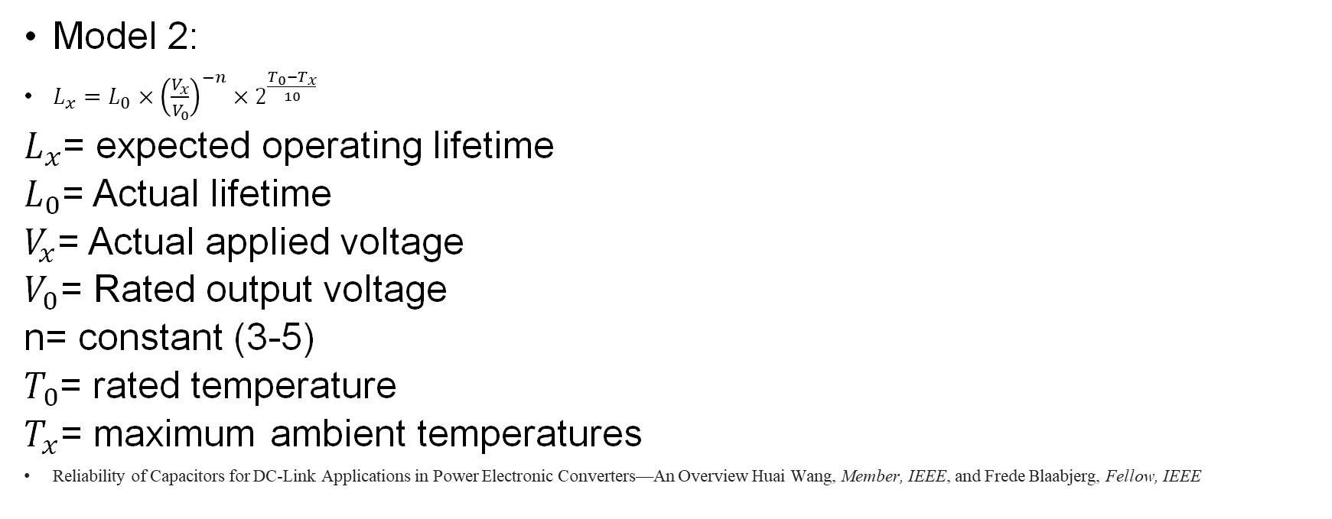
Model 2:
$L_{x}=L_{0}×{\left(\frac{V_{x}}{V_{0}}\right)}^{−n}×2^{\frac{T_{0}−T_{x}}{10}}$
$L_{x}$= expected operating lifetime
$L_{0}$= Actual lifetime
$V_{x}$= Actual applied voltage
$V_{0}$= Rated output voltage
n= constant (3-5)
$T_{0}$= rated temperature
$T_{x}$= maximum ambient temperatures
Reliability of Capacitors for DC-Link Applications in Power Electronic Converters—An Overview Huai Wang, Member, IEEE, and Frede Blaabjerg, Fellow, IEEE

Slide 6
A comparison of models
Model 1
Model 2
Do not consider voltage
Takes less information from physical system
Rarely used
Includes voltage
Takes more information form physical system
Commonly used

Slide 7
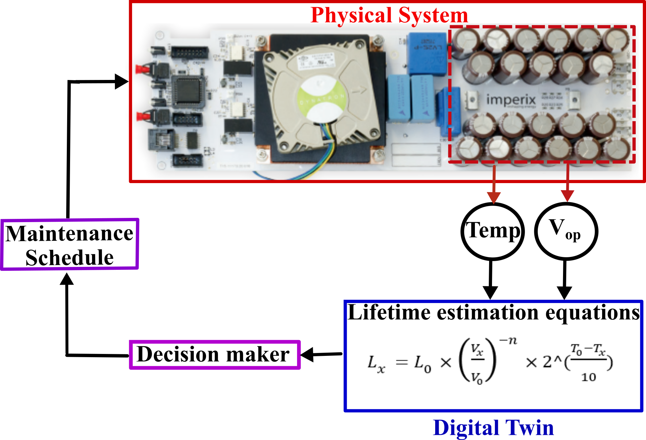
Proposed capacitor degradation model -DT
Block diagram showing DATA exchange between PT and DT.

Slide 8
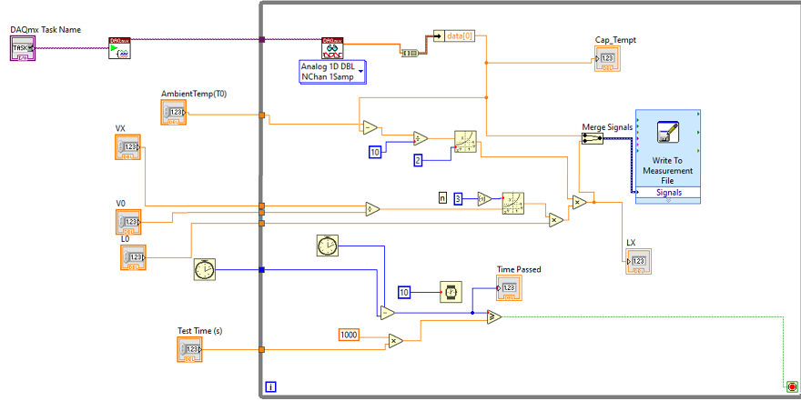
DT Results
Plots for Real time data from testbed data for 300 sec.
LabVIEW setup.
Plots for Real time data from testbed data for 60 sec.
Analytical model in Matlab.

Slide 10
Thanks!
Name : Aqarib Hussain
Email : ahussain@email.sc.edu

